Slide 1
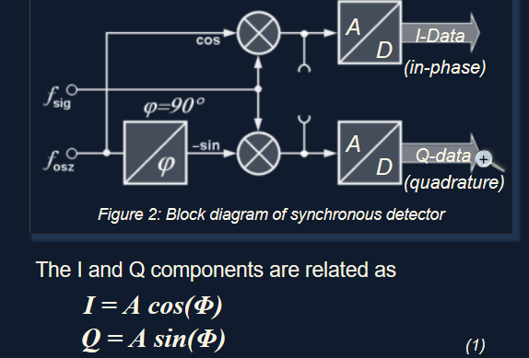
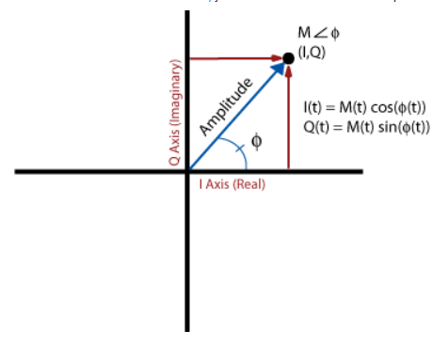
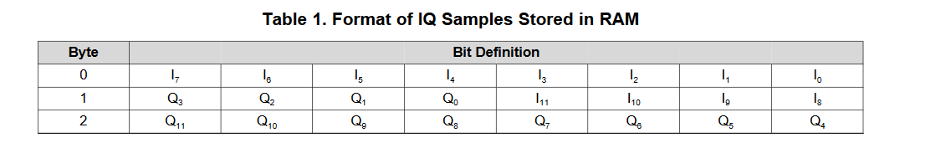
Calculate phase differences by comparing the I/Q data of the RF signal received at different CC 1310’s in real time (syncing samples in real time: possible processing delays?)
Phase angle between I/Q Signal 1 (ph2) =atan(Q/I) Phase angle between I/Q Signal 2 (ph1) =atan(Q/I) Phase difference = ph1-ph2

Slide 2
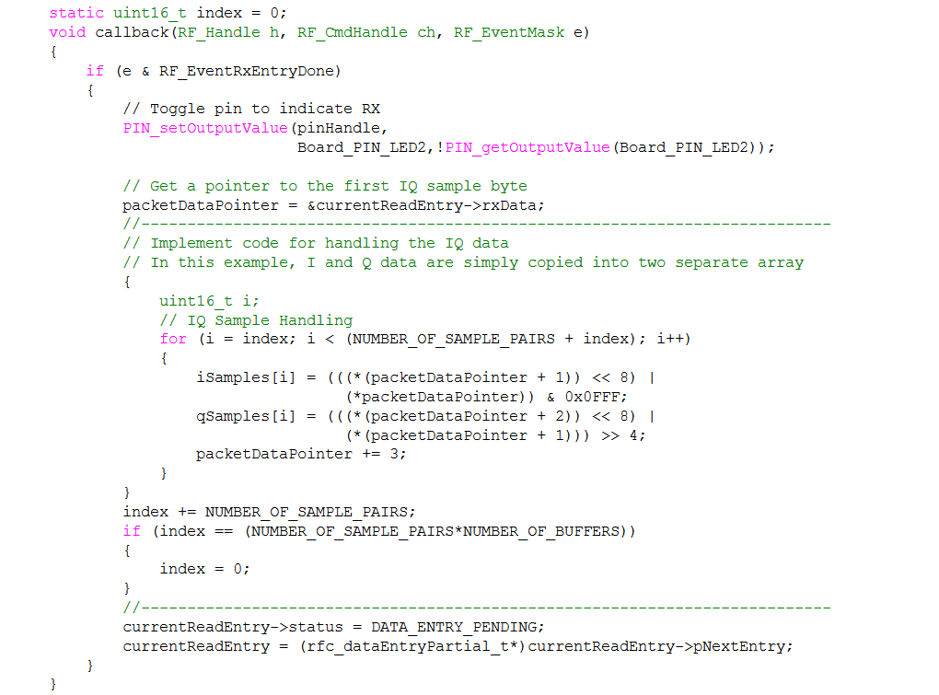
I/Q Sample Example Code (http://www.ti.com/lit/an/swra571/swra571.pdf):

Slide 3
Local
Oscillator
Antenna 1
Low Noise
Amplifier
CC1310 1
i1,q1,rssi1,ID
Watson-Watt pair 1
Antenna 2
Low Noise
Amplifier
CC1310 2
i2,q2,rssi2
DF Algorithm running on RaspberryPi
Antenna 3
Low Noise
Amplifier
CC1310 3
i3,q3,rssi3
Watson-Watt pair 2
Antenna 4
Low Noise
Amplifier
CC1310 4
i4,q4,rssi4
Notes:
TDOA

Slide 4
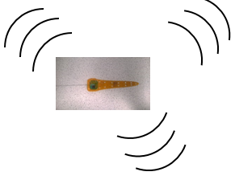

TRX 1
Automated phase-based telemetry receiver system
TRX 2
Local
Oscillator
Local
Oscillator
Antenna 1
Low Noise
Amplifier
CC1310 1
Antenna 1
Low Noise
Amplifier
CC1310 1
Antenna 2
Low Noise
Amplifier
CC1310 2
DF Algorithm running on RaspberryPi
Antenna 2
Low Noise
Amplifier
CC1310 2
DF Algorithm running on RaspberryPi
Antenna 3
Low Noise
Amplifier
CC1310 3
Antenna 3
Low Noise
Amplifier
CC1310 3
Antenna 4
Low Noise
Amplifier
CC1310 4
Antenna 4
Low Noise
Amplifier
CC1310 4
GPS
RxTx communication protocol
Compass
Energy harvesting
Time-keeping,
coordination w/txrs
coordination w/ rxrs
localization of receivers
Orienting antenna elements
Node-to-node VHF uplink
TRX3
Trilateration algorithm
Uses RSSI?
Machine learning w/ calibration beacons?
TRX4
Local
Oscillator
Bluetooth / VHF uplink to central hub
Local
Oscillator
Antenna 1
Low Noise
Amplifier
CC1310 1
Antenna 1
Low Noise
Amplifier
CC1310 1
Antenna 2
Low Noise
Amplifier
CC1310 2
DF Algorithm running on RaspberryPi
Antenna 2
Low Noise
Amplifier
CC1310 2
DF Algorithm running on RaspberryPi
Antenna 3
Low Noise
Amplifier
CC1310 3
Antenna 3
Low Noise
Amplifier
CC1310 3
Antenna 4
Low Noise
Amplifier
CC1310 4
Antenna 4
Low Noise
Amplifier
CC1310 4

